Slide 1
Ludocore: A Logical Game Engine for Modeling Videogames
Adam M. Smith (presenter), Mark J. Nelson, and Michael Mateas
amsmith@soe.ucsc.edu
CIG 2010 – Copenhagen, Denmark

Slide 2
Ludocore is a game engine that helps you model videogames.
Notes:
Here is simple statement.
Let me build some context around this statement before the bulk of the talk.

Slide 3
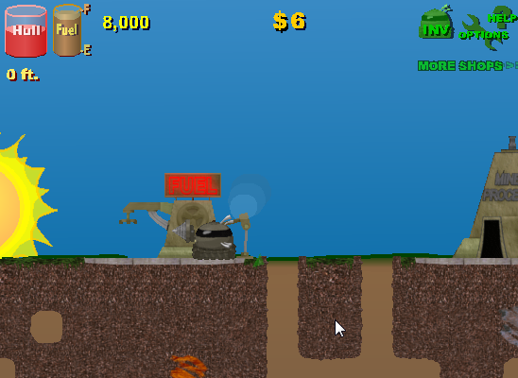
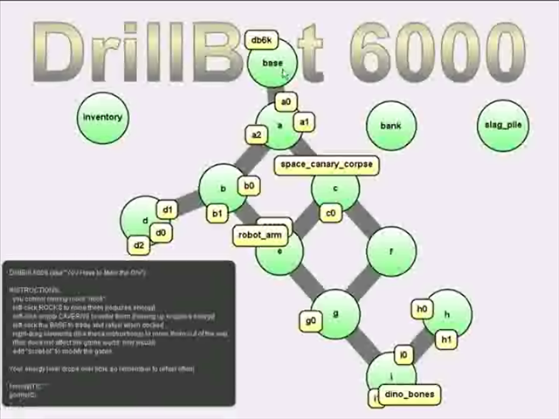
What is a model of a videogame?
Motherload
(XGen Studios, 2004)
DrillBot 6000
(Smith et al., 2009)
a complete game
a playable game sketch modeling a complete game
Notes:
Left: Motherload-- Mining robot, navigating a world, drilling out rocks to recover valuable ore, managing a continually draining energy supply, trade in rocks and refuel only at the top of the map
Right: db6k was created using our game engine with the same core mechanics, but art assets and other details stripped away
Note: Real games designers build prototypes like this as part of the design process for real games (abstract, programmer art, subset of complete mechancs). Making this kind of game as part of an experiment towards designing larger games is what separates prototypes from toy research games.
Keep db6k in mind, it will be my running example.

Slide 4
Why build models of videogames?
Models are easier to build than complete games.
AND
Playtesting these models leads to understanding of design ideas.
Notes:
Quickly building informative models is what Ludocore is all about.
Ludocore focuses on automated playtesting, but can be used with human players as well.

Slide 5


“Game engines”
Conventional game engines:
Solutions to game programming problems (physics, graphics, sound, network, …)
API or scripting language
Ludocore (a logical game engine):
Solutions to logical game modeling problems (actions, effects, expectations about players, …)
Sketching language
Notes:
Def: comprehensive software libraries for game development
In practice: a collection of code you would have had to re-write for every game, wrapped via an accessible interface
NOTE: models that you create with L are fed into an answer set solver which produces detailed gameplay traces
(no code in this talk)

Slide 6
Outline
Modeling approaches
Building up a logical game model
Use cases
Perspective

Slide 7
Modeling Approaches
State-transition formalisms
State over time leading to rewards…
…but games have rules
Game Description Language (Love et al., 2004)
Representation using logic programs
Game concepts (players, moves, goals)
Event calculus for game modeling (Nelson et al., 2008)
Independently modifiable rules
“Commonsense law of inertia”
Notes:
S-T (MDPs): misses the major point that games have RULES (some inherently factored rep of dynamic system from which gameplay emerges)
GDL: but much easier to specify, still S-T at the core, ultimately designed to learn about (GG)players, not game designs
EC: is a logic language for representing and reasoning about actions and their effects
Rules: swap in/out, better resonates with how real games are defined – don’t write out a complete trans function, it emerges from rules
CLoI: imperative updates to state variables in game code;
So: ec has properties we really want, but missing a game vocabulary and playtesting tools
Ludocore: higher level formalism specific to building game models

Slide 8
Building up a logical game model (Step 0)
A complete, logical game model
Each box is a pile of logical assertions.
Game-specific
Common
Notes:
Models in our engine are made of components that incrementally build on each other.
You could just write an ad-hoc game model from scratch (we did many times!), but this factoring seems to be useful.
Fill up this diagram over the next few slides

Slide 9
Building up a logical game model (Step 1)
Temporal logic foundations
Idea: A small set of axioms defines truth-over-time.
Concepts:
timepoints
fluents
events
initiation/termination
traces
Event Calculus
Notes:
Temporal logic: We’ve found it useful to use EC as a base (vs something ad-hoc).
Timepoints map to game simulation ticks
Fluents are conditions that can change over time (subject to CLoI), map to tables of game state
Events instantaneous occurences, straight-forward
Pluggable init/term rules, map to event handling logic in games
Traces are logs of events and world state over time.
Existence of interesting traces and their contents is where the design understanding comes from.
TL: can be used to arbitrary systems with state change over time -- but: we focus on modeling systems which could reasonable be described by the code implementing some game

Slide 10
Building up a logical game model (Step 2)
A theory of playable simulations
Idea: Upgrade the foundation for the common problems of game modeling.
Game Engine
Concepts:
game state
game events
player/nature models
Event Calculus
Notes:
NOTE: use drillbot examples
State: raw inertial state + computed views + implicit current-time (ex: occupied(Pos) ~ rock(R),in(R,P),holds(present(R),T) ,T=now)
Events: conflict (mine and trade) vs. possibility (mine with energy) vs. selectability (trade with empty inventory)
Player/Nature: tag subsets of game events as player actions or spontaneous/triggered actions (player’s avatar movement vs. NPC movement)
Models: pluggable, selection policies for events (more later)
MISSING: scoring, victory conditions (possible to build, but not necessary for most models)
PRESENT: structure which supports the our factoring of game models, the dotted-line boundaries

Slide 11
Building up a logical game model (Step 3)
A specification of a game
Idea: Quickly implement the game’s world in terms of foundational concepts.
Game Engine
Game Rules
State
Events
Consequences
Nature model
------------------------------------------
Supporting concepts
World configuration
Dynamic
Timeless
Event Calculus
Notes:
Given high-powered concepts in the background theory, Db6k is relatively easy to describe
State: robot is at position with some energy, rock is present
Events: mining, moving, refueling (only refuel at base, only move to empty cavern)
Consequences: moving reduces energy (and changes position!), refueling restores it
Nature model: spontaneous energy drain (slow leakage over time, not a player’s move, but keeps happening, blame on nature)
S Concepts: non-dynamic, but still critical definitions (how many energy levels there are, energy cost of actions)
W Configuration: concrete level design and item specs (cavern network, tagging some rocks as treasure)

Slide 12
Building up a logical game model (Step 4)
A model of expected play
Idea: Plug in your knowledge of players to improve model accuracy.
Player Model
Game Engine
Game Rules
State
Events
Consequences
Nature model
------------------------------------------
Supporting concepts
World configuration
Concepts:
player_asserts
player_forbids
Event Calculus
Notes:
Modeling the game’s rules isn’t enough to produce an informative model.
There is a big gap between what is technically possible in a game and what you see during play (conj: game design is all about understanding this gap!). Demonstrating and documenting that gap is an important function of a game model (a play model, really).
Asserts: refuel robot is at the base and under half energy
Forbids: no mining if there are more than 5 rocks in the inventory
Default model says anything goes. Pile-on to incrementally carve away unrealistic behavior.

Slide 13
Building up a logical game model (Step 5)
A focused view of some play situation
Speculative Assumptions
Idea: Throw on extra constraints to zoom-in on situations of interest.
Player Model
Game Engine
Game Rules
State
Events
Consequences
Nature model
------------------------------------------
Supporting concepts
World configuration
Ask questions by…
Posing scenarios
Search with goals
Optimizing metrics
Event Calculus
Notes:
Player model restricted the game model to only realistic gameplay traces.
SAs do the same thing, restricting the model to only interesting traces (with interestingness at the whim of the designer).
Scenarios: alternative initial conditions
Goals: something that must be true of every trace the model admits
Metrics: compute numerical score for any trace, ask to minimize or maximize
Wrap up: this is what it takes to specify an informative model (requires modeling a focused view of some play situation)

Slide 14
Using Ludocore models
Method:
Assemble speculative assumptions.
Request gameplay traces.
Use cases:
Running the simulation…
Forward
Backward
Sideways
Structural queries
Human playtesting
Notes:
Method: (concretely)
Writing a little bit of code
- Running our command-line tool

Slide 15
Running the simulation…
Forward:
Traces starting from some initial conditions
Backward:
Traces ending in some final conditions
Sideways:
Traces matching some conditions across time
happens(mine(a1),0).
happens(drain,1).
happens(drain,2).
happens(trade,3).
happens(mine(a2),4).
happens(mine(a0),5).
happens(down_to(a),6).
happens(mine(space_canary_corpse),7).
happens(mine(c0),8).
happens(down_to(c),9).
happens(down_to(f),10).
happens(up_to(c),11).
happens(up_to(a),12).
happens(down_to(c),13).
happens(down_to(f),14).
A DrillBot 6000 event trace
Notes:
Initial conditions: robot starts underground with low energy. What can happen next?
Final conditions: all rocks are collected at t=10. How did this happen?
Partial spec: t=1..20, refueling only happened once (don’t know/care when). How did the robot survive?
Event trace at right is actual output from design tools.

Slide 16
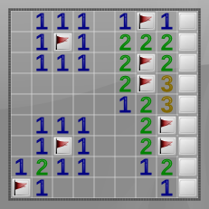
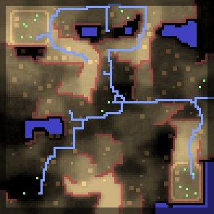
Structural queries
Method:
Mark certain elements of world configuration as flexible.
Request gameplay traces including specific configurations.
Determining mine positions in Minesweeper
Placing roads, buildings, and cliffs in Warzone 2100
http://warzone2100.org.uk/manual-diorama.html
Notes:
Instead of trying to learn about the dynamic part of your game’s rules. SQs can tell you about the timeless/static parts of the rules.
Minesweeper: What placements of mines on the map are consistent with the current visible game state? Puzzle solver in ~100 lines.
Wz2100: What building locations and terrain heights are consistent with certain strategic-fairness constraints? We didn’t do this work, but the developers use the same logic tools we do.
~ with our engine you could extend this procedural content generation with dynamic, gameplay contraints
The magic: write down the mechanics for forward simulation and get a puzzle solvers and procedural content generators almost for free

Slide 17
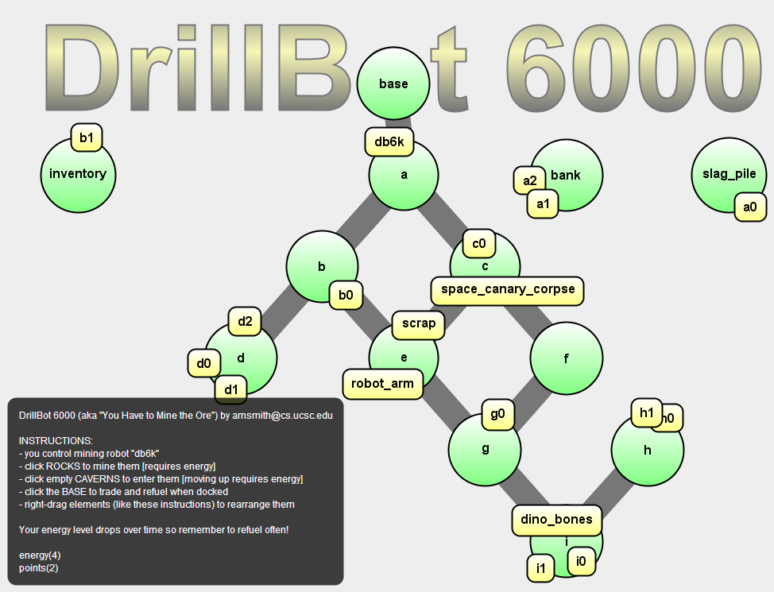
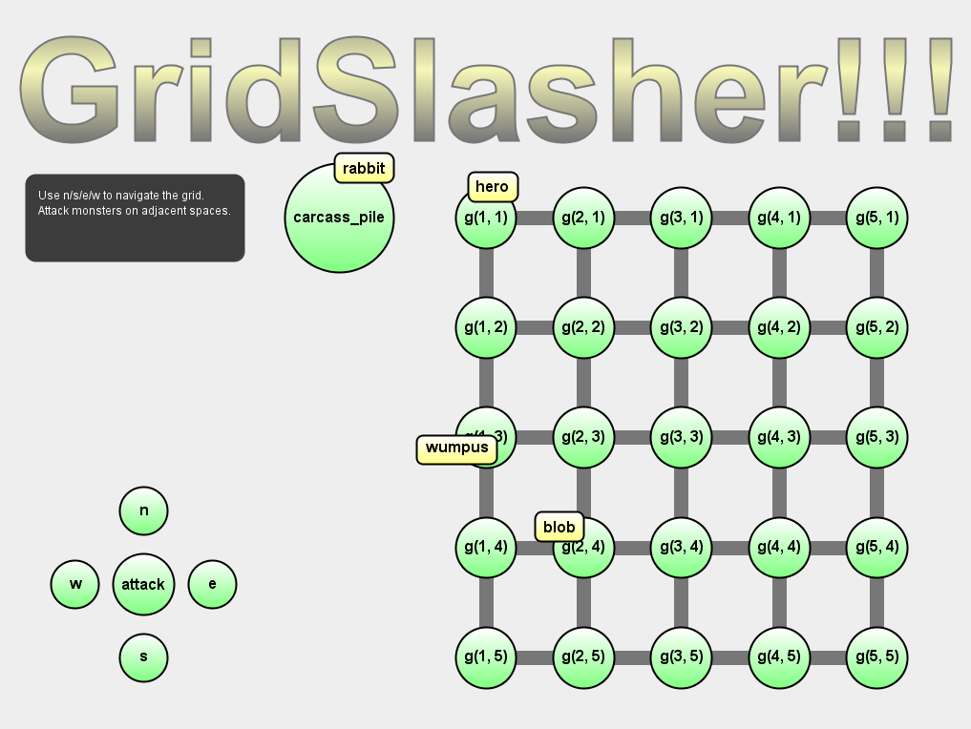
Human playtesting
Use a human playtester instead of the engine’s included solver. (Smith et al., 2009)
Answers for…
Engagement?
Fun?
Hesitation?
Notes:
The Ludocore engine is heavy machinery behind Biped, a dual support prototyping tool we presented elsewhere.
Letting a human play the role of an incremental forward simulator is relatively easy (computationally speaking).
Human players reveal information that can’t be read from a symbolic trace.

Slide 18
Perspective
Ludocore doesn’t solve design problems.
It provides intelligent feedback that helps humans solve design problems.
Forward simulation: “Here’s an obvious bug!”
Backward simulation: “My puzzle has no shortcuts.”
Structural queries: “99 new level designs!”
Human playtesting: “Players always go left at the fork.”
Notes:
It can’t say a game is good or bad, but it can the provide objective feedback you need to form your own opinion.
Taking this feedback and deciding the next gameplay experiment is what game design is all about.

Slide 19
Conclusion
Ludocore provides a powerful representation for games and design expectations.
Ludocore models supports focused, machine playtesting.
One logical game model can enable a variety of uses.
Notes:
Design expectations: structure outside of just the game’s rules is critical for making the model informative.
Machine playtesting: respects documented assumptions about real player behavior.
Using logic for PCG? Come to my talk tomorrow at 11!

Slide 20
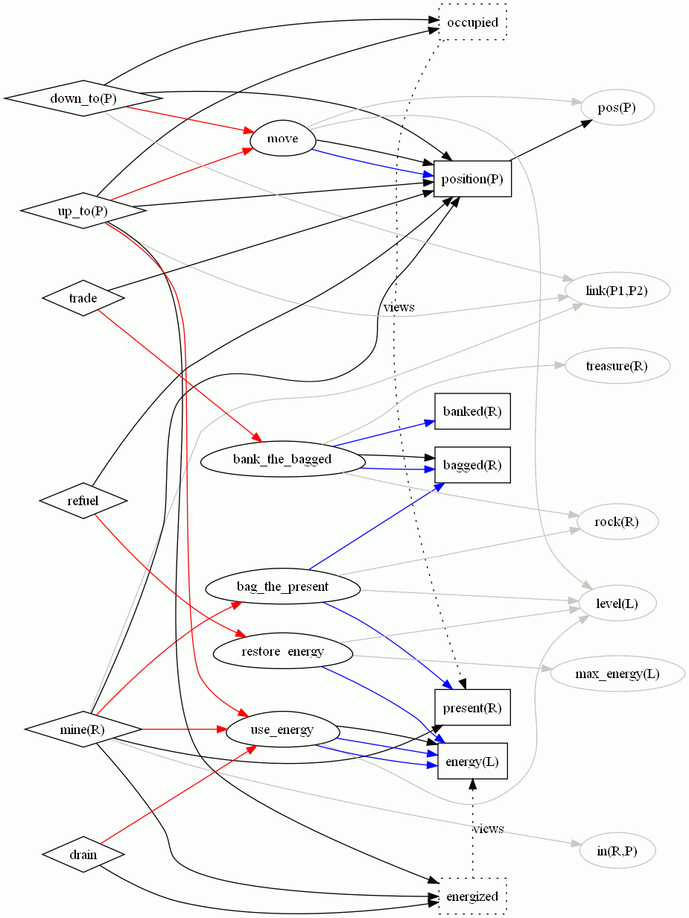
Thank you
Ludocore: A Logical Game Engine for Modeling Video Games
Presenter:
Adam M. Smith
amsmith@soe.ucsc.edu

